Slide 1
Permission to use this presentation is authorized provided credit is given to David L. Charney, MD
NOIR4USA.org

Slide 2
By David L. Charney, M.D./NOIR for USA
Psychiatrist Specializing in the Mind of the Spy

Slide 3
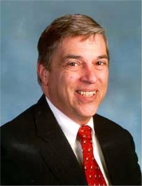
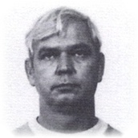
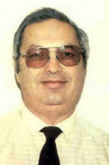
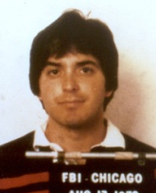
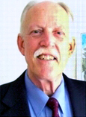
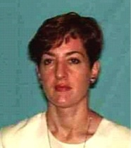
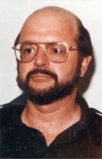
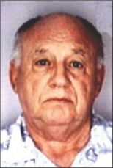
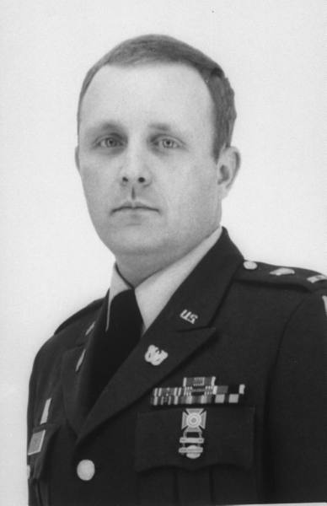
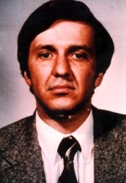
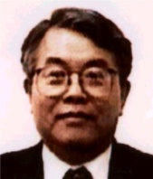
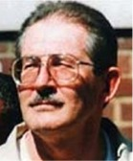
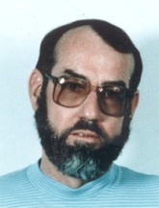
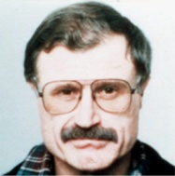
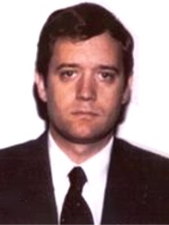
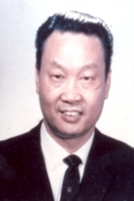
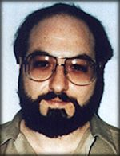
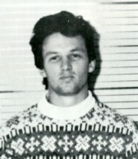
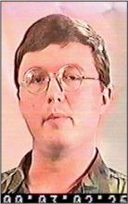
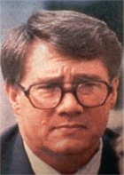
Spying: A BIG Problem
What’s being done to manage the problem?
Initial Screening
Reinvestigations
High-tech detection
Counterintelligence units
How is it working?
Detection rarely works
Dirty little secret:
Cases usually solved when someone defects from the other side
What’s been missing?
Better understanding the mind of the spy

Slide 4
How I Became An Expert in the Mind of the Spy
Training in Psychiatry
Air Force Psychiatrist
Strategic Air Command
Andrews AFB
Treated NSA Personnel
Received a Security Clearance
Thought about becoming a CIA consultant
Intimidating application so “maybe later…”

Slide 5
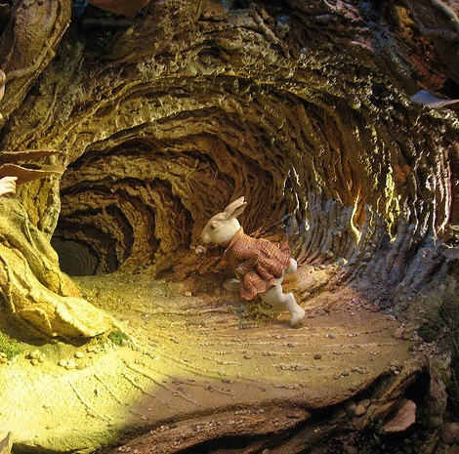
Down the Rabbit Hole by Accident
Solo Private Practice, Old Town, Alexandria
Group Practice that needed staffing up
Just one more Social Worker—and I’m in!
A decade of treating CIA and other IC personnel
Squash game leads to Earl Pitts
Luck of practicing near the Rocket Docket

Slide 6
Access is Key
Government psychologists and psychiatrists have access
Brief evaluations, adjudications
No long-term therapy
Defense Team has access
Freedom to intensively engage with captured spy
No one else has access
They don’t have clearances

Slide 7
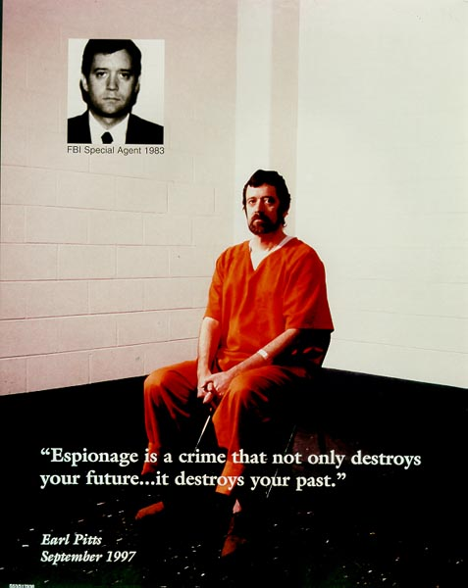
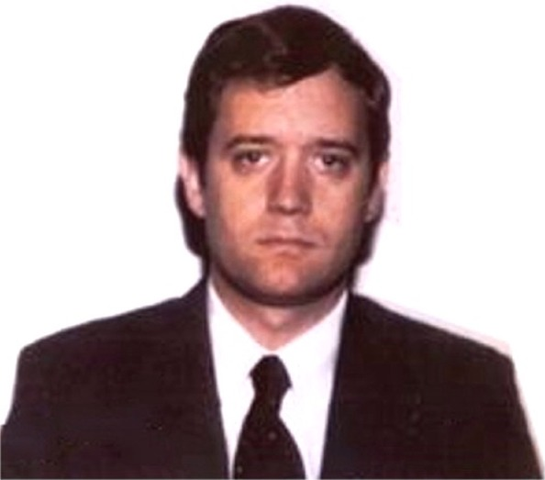
My First Meetings with Earl Pitts
A bargain struck:
“I’ll be your guinea pig”

Slide 8
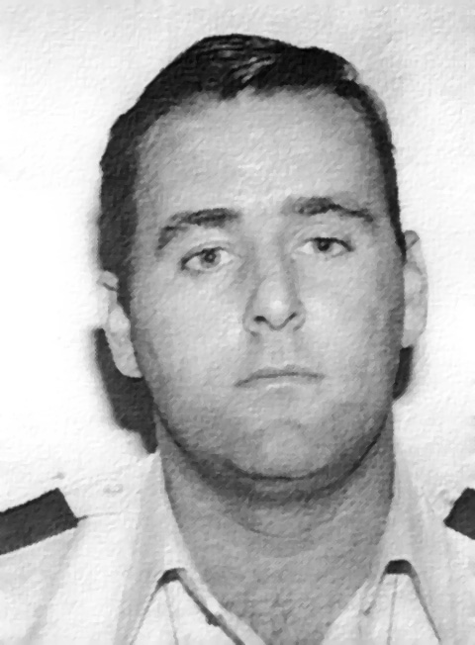
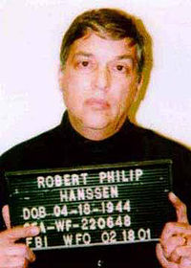
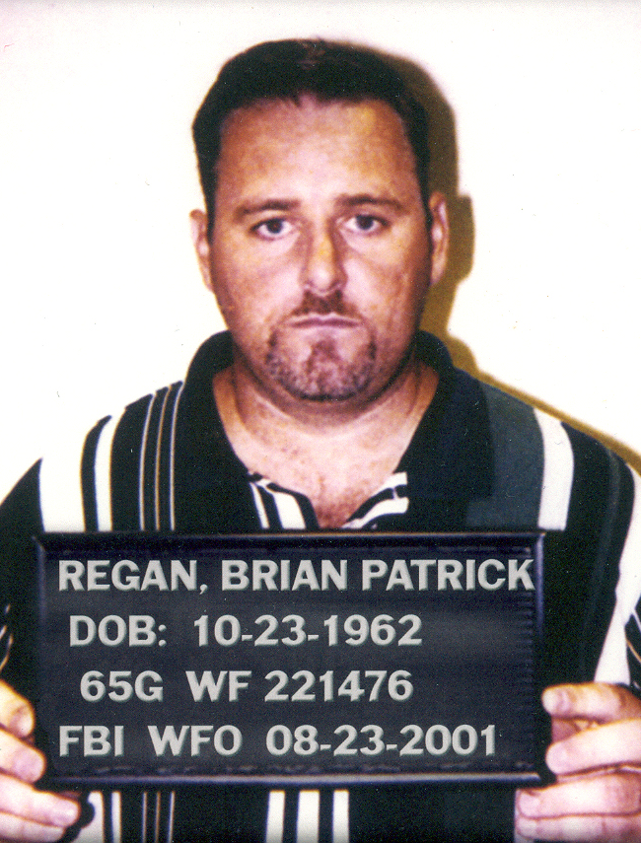
Deepening the Knowledge - More Than One Case

Slide 9
Growing the Relationship
Listening is the key
Art of keeping mouth shut
Nature of the Relationship
Forensic Psychiatrist?
Doctor-Patient?
Therapist?
Confidante?
None or all of the above?

Slide 10
Predictable By Design
Same Routine
Same Location
Same Clothing
Intensity of Contact
Weekly, for up to two hours, for a whole year

Slide 11
A spy is the loneliest person in the world
Empowers the handler
My role mirrors the handler, but without exploitation
Tone: Mutually cooperative enterprise

Slide 12
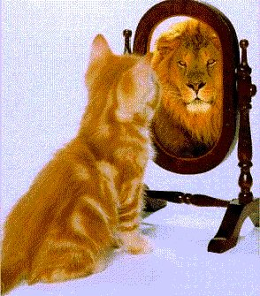
Starting Assumptions About Motivation
Conventional concepts of spy motivation:
Greed and Money
Of MICE and Men
Money
Ideology
Compromise
Ego

Slide 13
If We’re So Smart About This, Why Does it Keep Happening?
Bell-Shaped Curve of Life
An unlucky few get stuck at the bad tail
But which ones?
The Law of Large Numbers

Slide 14
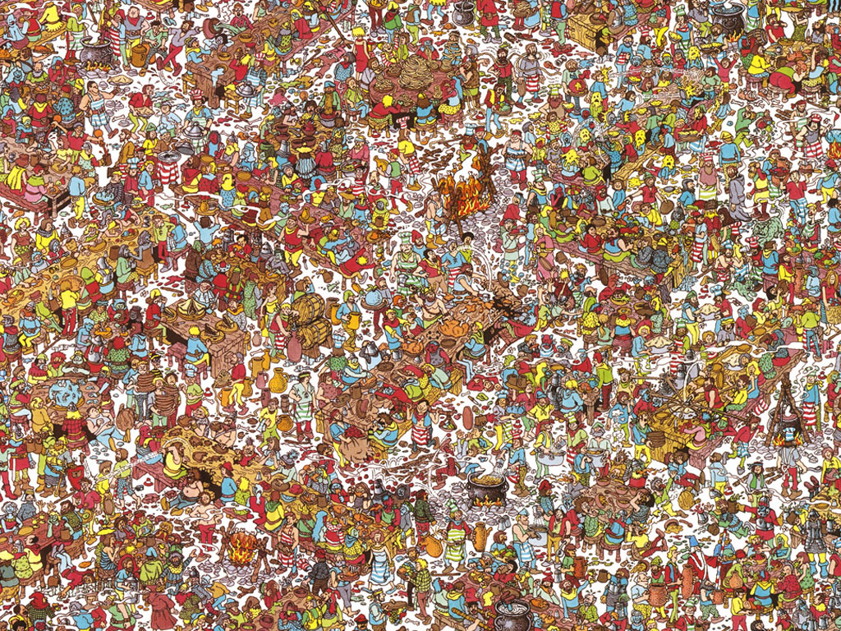

Slide 15
Finding Spies Subject to Iron Law of Economics
Law of Diminishing Returns
More and more effort is required to get back less and less

Slide 16
Tradeoffs in Screening for Spies
False Negatives—Missing some spies
False Positives—Wrongly accusing others
Too much investigation will hurt morale

Slide 17
Conventional Theories of Motivation? Not What I Found!
“To every complex problem there is a simple answer. And it is wrong.”
—H.L. Mencken
Importance of asking: Why?
More than once, like a 4 year old
Why do people eat in gourmet restaurants?
Because they’re hungry (??)

Slide 18
I’m a Doctor—I Discover the Genetic Marker for Spies
The Y Chromosome!
95% of spies are male
Male pride and ego

Slide 19
Gender Counts
Career
Men want to be good providers
Cannot lose respect in eyes of wife
Relationships
Women feel like failures if they don’t feel loved
Female spies are trying to fix that problem

Slide 20
Core Psychology of the Insider Spy
An intolerable sense of personal failure,
as privately defined by that person.

Slide 21
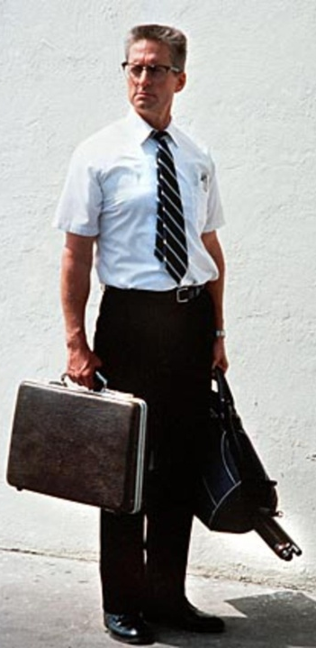
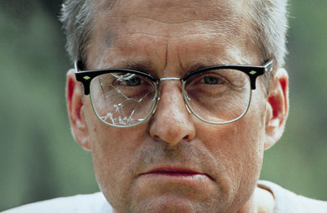

Slide 22
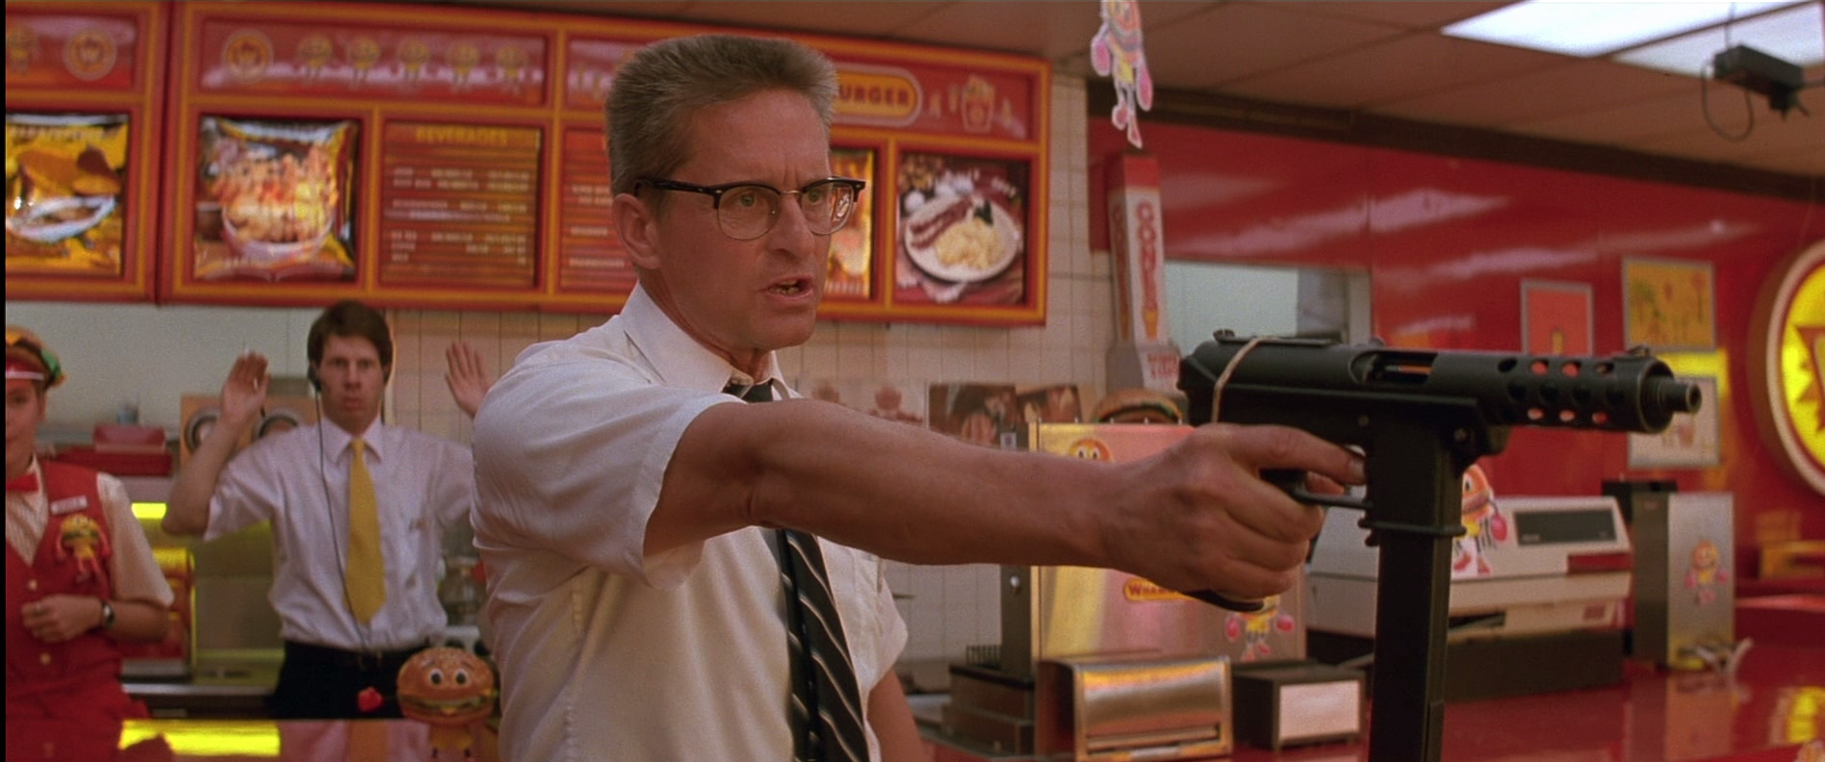
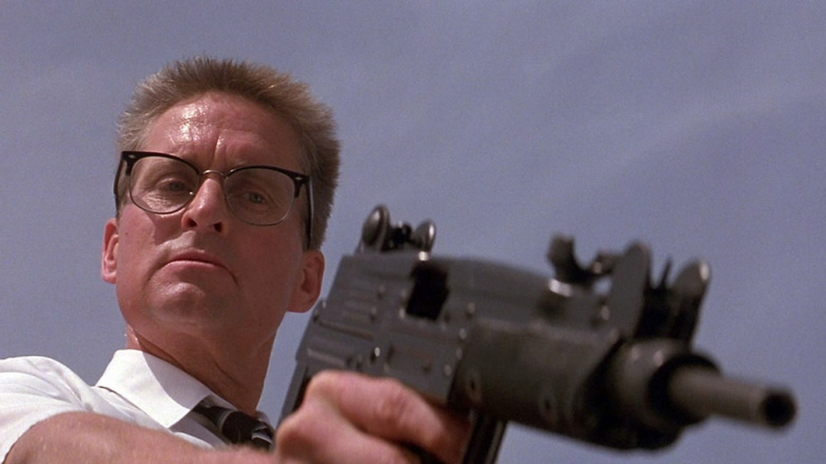
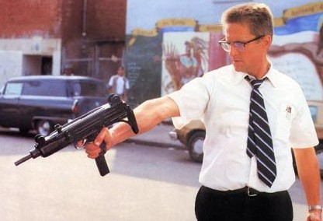

Slide 23
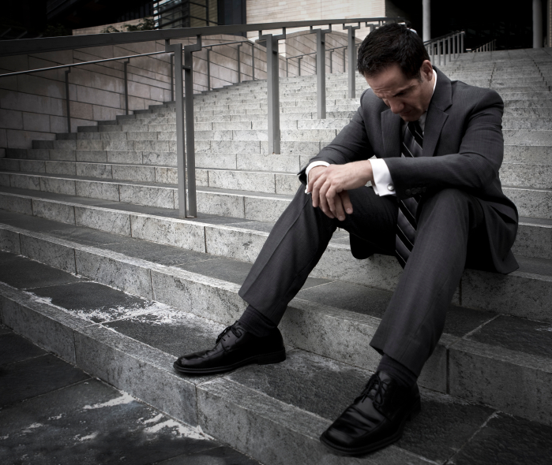
Spies are Unhappy
An intolerable sense of personal failure as privately defined by that person.
Most are not “recruited” or do not volunteer until after 30 years old
After they have had time to try and fail.

Slide 24
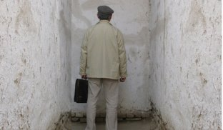
The Holy Grail: The Perfect Profile of the Spy
A blind alley
Spies are not born; they’re made
Still Photo vs. Movie
Not static: Not one Perfect Profile, like a snapshot
Dynamic: Stuff happens, more like a movie unfolding
Epigenetic theory
Life happens
Brings forth hidden tendencies: Good ones—but also BAD ones

Slide 25
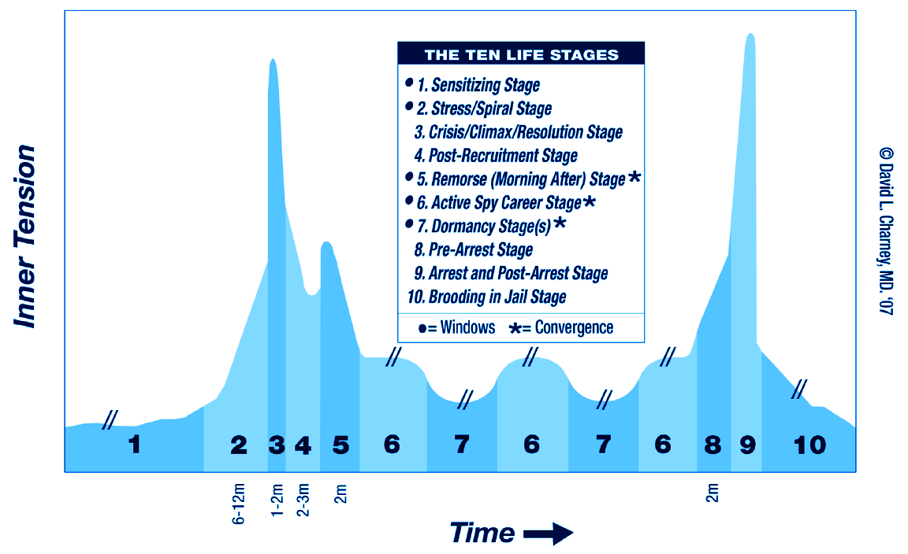
Ten Life Stages of the Insider Spy

Slide 26
Sensitizing stage
Stage One

Slide 27
1
Nearly everyone experiences adversity
If every early adverse life experience produced a spy outcome
85% of all Law Enforcement, Military and Intelligence Personnel would have to be let go!
Sensitizing but not determinative

Slide 28
Stress / spiral stage
Stage Two

Slide 29
2
Acceleration
Things start to pile up six months before decision to spy is made
“Psychological Perfect Storm”
Too many bad things all at once
Feels like drowning

Slide 30
Crisis / climax / resolution stage
Stage Three

Slide 31
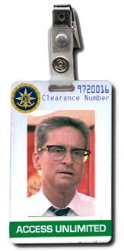
3
“Personal Bubble Psychology”
Cornered, but desperately reaching for a Survival Strategy
Aha! Epiphany of a Solution
Context is key
Going postal— BUT WITH ACCESS

Slide 32
Post-recruitment stage
Stage Four

Slide 33
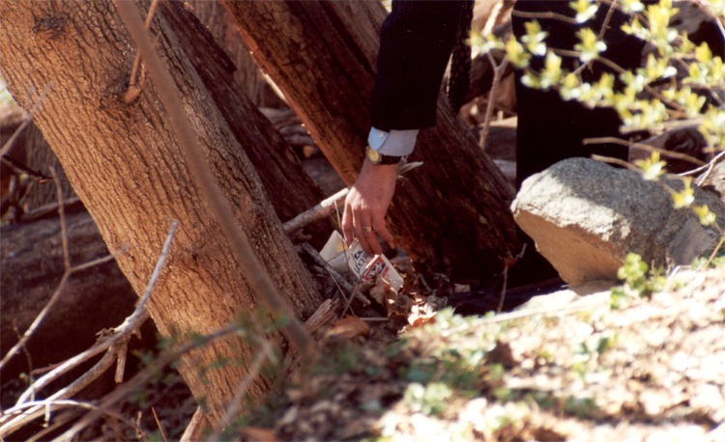
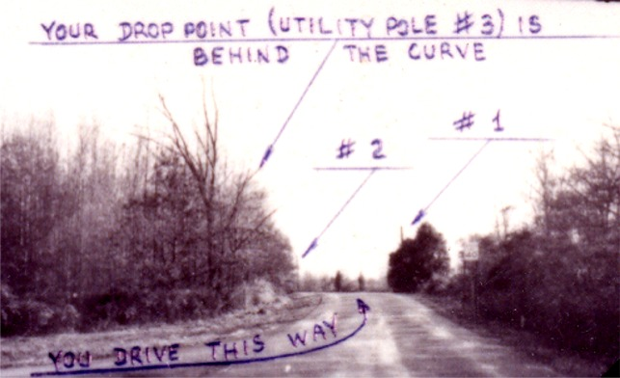
4
Euphoria
A month or so
Learning new tradecraft skills

Slide 34
Remorse / morning-after stage
Stage Five

Slide 35
5
“What was I thinking?!”
Recognition of being stuck and trapped: No turning back

Slide 36
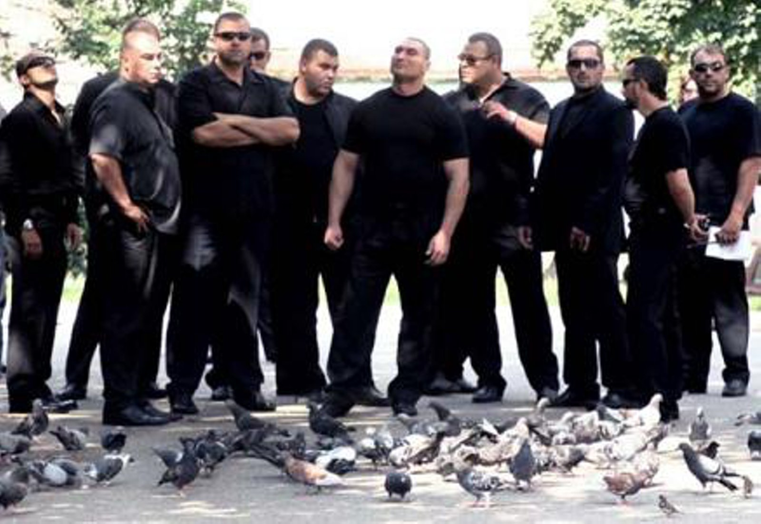

Slide 37
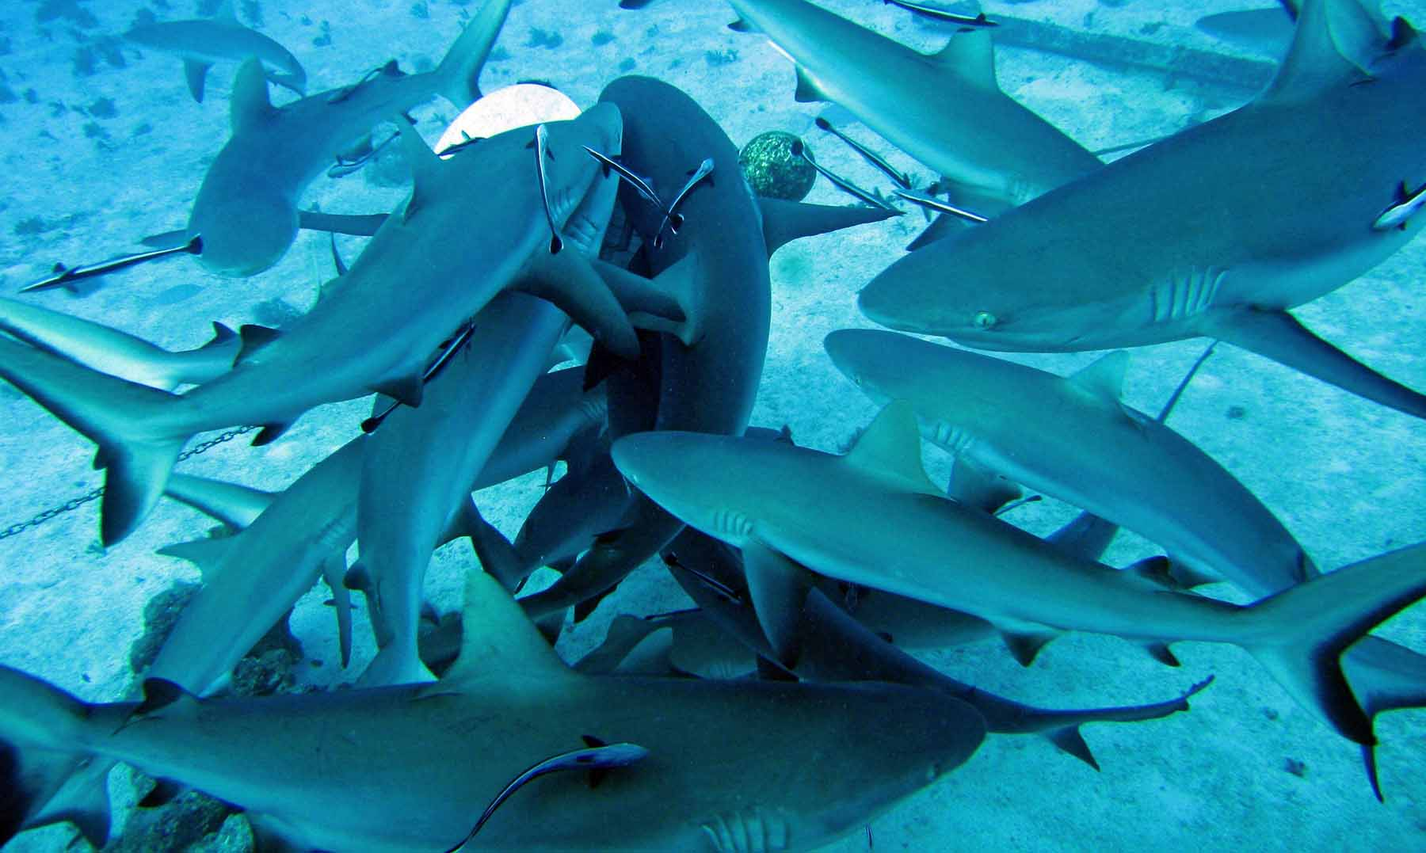

Slide 38
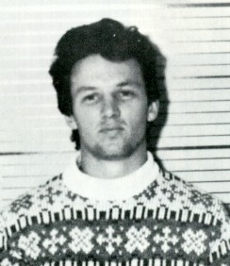
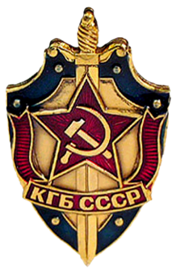
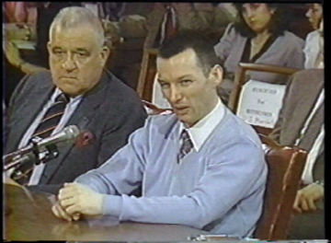
Christopher Boyce
Young TRW employee with a Top Secret US Government security clearance from CIA
With friend Daulton Lee, decided to sell classified spy satellite information to the Soviet KGB for money
1977: Arrested; sentenced to life in prison
April 1985: Boyce testified at hearings before the Senate Permanent Subcommittee on Investigations which concerned the US Government Personnel Security Program.

Slide 39
Christopher Boyce on Stage Five
“For whatever reason a person begins his espionage, a week after the folly begins, the original intent and purpose becomes lost in the ignominy of the ongoing nightmare.
“Where was the despair? Where were the sweaty palms and shaky hands? This man said nothing about having to wake up in the morning with gut-gripping fear before steeling yourself once again for the ordeal of going back into that vault.
Notes:
Christopher Boyce was a young TRW employee with a Top Secret US Government security clearance who decided, along with his friend Daulton Lee, to sell classified satellite information to the Soviet KGB for money. They were caught in 1977 after committing espionage for two years and sentenced to life in prison. In April 1985, Boyce testified at hearings before the Senate Permanent Subcommittee on Investigations in Washington, DC, which concerned the US Government Personnel Security Program. During the proceedings, Boyce submitted a written statement of his spying experiences, the conclusion of which says:

Slide 40
Christopher Boyce on Stage Five
“None of them knew, as I did, that there was no excitement, there was no thrill.
“There was only depression and a hopeless enslavement to an inhuman, uncaring foreign bureaucracy.
“If a person knows what espionage would mean to him, what kind of life he would have in the future, it’s just so totally an unattractive thing to be into—you’re never going to get away from it and it’s never going to end.
“I would tell them they are going to regret it, that there just isn’t anything about it that is how it’s pictured in the public’s mind. There’s no exit from it.
Notes:
Christopher Boyce was a young TRW employee with a Top Secret US Government security clearance who decided, along with his friend Daulton Lee, to sell classified satellite information to the Soviet KGB for money. They were caught in 1977 after committing espionage for two years and sentenced to life in prison. In April 1985, Boyce testified at hearings before the Senate Permanent Subcommittee on Investigations in Washington, DC, which concerned the US Government Personnel Security Program. During the proceedings, Boyce submitted a written statement of his spying experiences, the conclusion of which says:

Slide 41
28 YEARS LATER— Boyce’s Stage Five is STILL on his mind

Slide 42
Boyce on Snowden (CNN, June 2013)
“If I were him, I would at this point probably be having second thoughts. Asking myself: What did I do? What have I brought down upon my head? Did I really do this?”
“I feel for the guy, and for what his life is going to become. I pity him.
“He's in for a world of hurt, for the rest of his life. …in the end, it'll end badly for him -- one way or another, they'll get their hands on him. He's doomed.
“I think he's scared to death. He's probably worried that there is a large group of people in Washington, D.C., trying to come up with some way of getting back at him, to get control of him, to lock him up for the rest of his life.
“He is utterly vulnerable and knows that there are a lot of people who really want to hurt him now.
“He can never come back home. He's totally separated from everything he has ever known, from his family. He is always going to be a fugitive, until they get him. And eventually, they will.
“He will never see his family again. The only way that he can truly hide is to abandon his whole past, his entire life.
“When he realizes that, he's going to be racked with depression. I would imagine that his stress levels are at a point where they could actually make him physically sick. I'm sure everything is gnawing at him. And he's isolated.
Notes:
http://www.cnn.com/2013/06/14/world/asia/hong-kong-boyce-snowden/
Convicted U.S. spy Christopher Boyce: 'Snowden is doomed'

Slide 43
Chris Boyce on Committing Espionage
“I realized immediately that:
There was no stepping back
I was doomed
My life would never go back to the way it was before
I was surrounded by an impending sense of doom, knowing this was something that could not end well. . . .
What you’re really doing is just walking into a buzz-saw.”
CNN, 2013
Notes:
www.cnn.com/2013/06/14/world/asia/hong-kong-boyce-snowden/
Convicted U.S. spy Christopher Boyce: 'Snowden is doomed'

Slide 44
Active spy career stage
Stage Six

Slide 45
6
Rationalizations
I can spy for years & years
The bad things I do have a good side
I have no other choice
Constant Stress
Uncertainty
The most corrosive state for anyone
Can’t plan, can’t think straight
Paranoia
Fear of someone on the other side turning you in
Getting caught

Slide 46
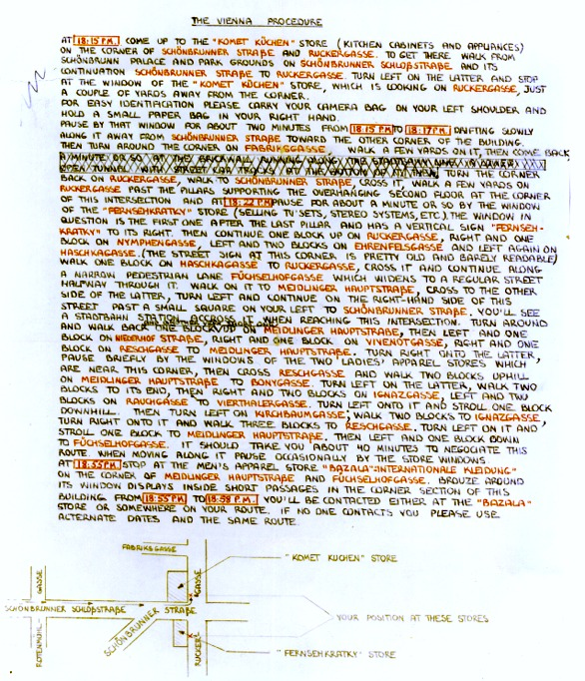
What was exciting is now drudgery, exhausting
Notes:
Actual KGB note to spy John Walker

Slide 47
Dormancy stage
Stage Seven

Slide 48
7
Fantasy of escape
Puts the lie to assumption of an Evil Genius

Slide 49
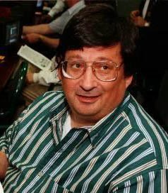
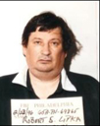
Robert Lipka: Spied in the 1960’s, Caught in the 1990’s
“When I first got into it, I didn't realize what it all meant. As I was doing it, I did come to realize and I did try to withdraw numerous times. I’ve lived a life of terror for 30 years that this whole thing would get found out.”
Notes:
http://www.fbi.gov/philadelphia/about-us/history/famous-cases/famous-cases-robert-lipka-an-american-spy
Robert Lipka, An American Spy
When Robert Lipka was a 19-year-old soldier in the U.S. Army assigned to the National Security Agency (NSA) at Ft. Meade, Maryland, he made a decision—a decision to betray his country for cash. From 1964 to 1967, he was assigned to the Collections Bureau, later renamed the Priority Materials Branch. His principal assignment was to remove classified NSA national defense documents from teleprinters and deliver them to the appropriate departments. However, Lipka often hid these classified documents on his person to escape detection from NSA security and used a common espionage technique known as a “dead drop” to transfer these documents to the KGB and then retrieve payment at a prearranged site. Lipka, whose KGB code name was “Rook”, also possessed spy cameras to clandestinely photograph sensitive documents.
In August 1967, Lipka resigned from the Army and moved to Lancaster, Pennsylvania, where he attended college at a local university. When he left, he took more classified NSA documents with him.
An independent investigation regarding two individuals, Peter and Ingeborg Fischer, indicated that they were most likely German/Russian operatives acting at the behest of the KGB.The investigation further revealed that the Fischers had made contact with Lipka in 1968. When the agents discovered that Lipka used to work at NSA, they suspected he had been the spy utilizing the code name “Rook.”
Minox spy camera and a “dead drop” site and map.In 1993, based on the information developed from the Fischer investigation and a book written by a former KGB Major General which contained a detailed description of espionage committed by a young soldier at NSA in the mid-1960s, an FBI undercover agent posing as a Russian military intelligence official contacted Lipka. Because the undercover agent knew his correct code name, Lipka agreed to several face-to-face meetings in Lancaster, Pennsylvania and Baltimore, Maryland. During these meetings, Lipka complained that the KGB had not paid him enough money for the NSA documents he had transferred and accepted $10,000 as the balance due for his past espionage activities.
With no statute of limitation for espionage, on September 24, 1997, more than 30 years after his crime of betrayal, Lipka was sentenced to 18 years in prison.

Slide 50
Pre-arrest stage
Stage Eight

Slide 51
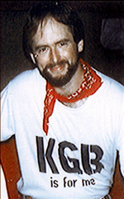
8
I’m not that stupid; I know you’re on to me!
Let’s get it over with!
Notes:
Photo of CIA Case Officer Jim Nicholson, who spied for the Russian SVR

Slide 52
Arrest and post-arrest stage
Stage Nine

Slide 53
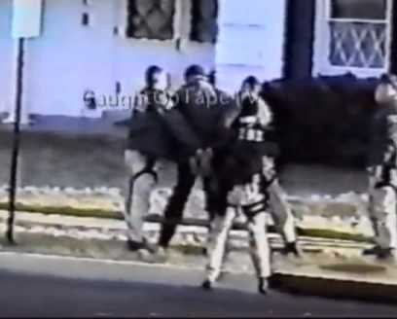
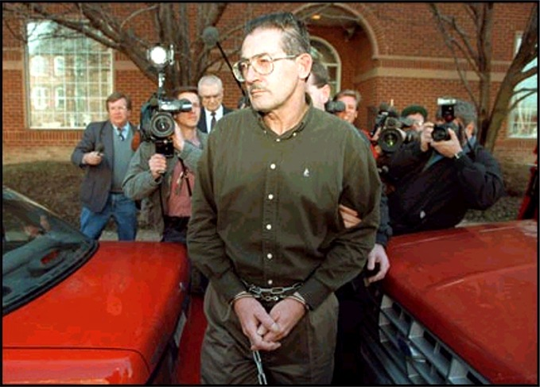
9
Return of the Defiant Teenager: Insolence and belligerence
Gives the wrong impression
It’s actually his Third Failure—and his shame is made public too

Slide 54
Brooding in jail stage
Stage Ten

Slide 55
10
Sadder, wiser, philosophical
Unexpected displays of patriotic sentiment and gratuitous advice
Notes:
Clockwise: Jonathan Pollard, Jim Nicholson, Earl Pitts, Rick Ames

Slide 56
“I regret the actions I took. they were wrong. They overshadowed anything good I’ve done in my life before and after. I’m glad it’s over.” —Former NSA employee and Russian spy David Boone
“There is nothing good that came as a result of my actions. I tried to serve two countries at the same time. That does not work.” —Former Navy analyst and spy for Israel, Jonathan Pollard
“I regret very much the betrayal of the trust they put in me, and of the oaths that I swore, and that I did it for my own gain and then my own arrogance.” —Former CIA officer and Russian spy Rick Ames

Slide 57
Existential Dilemmas of the Insider Spy

Slide 58
Existential Consequences
Failure upon failure
Inability to successfully navigate his own life
Discovering his best attempt to solve his worst life crisis turned out to be a pathetic delusion
Could not even succeed at being a spy
Stuckness
State of paralysis; unable to steer course of his own life
Loss of control over his life

Slide 59
Ten Life Stages of the Insider Spy

Slide 60
Existential Consequences
Convergence of psychology
Fear of being caught
Constant grinding uncertainty
Waiting for the other shoe to drop
Yearnings for deliverance and relief
Despair and hopelessness about direction of life

Slide 61
Why Current Strategies Don’t Work Very Well

Slide 62
Misunderstanding the mind of the spy
Trying the same old things, hoping for better outcomes
Clinging to the idea of building better technology-based mousetraps
Fig leaf of EAPs
Distrust
They won’t go there

Slide 63
Time for something new

Slide 64
NOIR
Check out the website: NOIR4USA.org
Three Part White Paper on Insider Spies
Part One:
“True Psychology of the Insider Spy”
Part Two:
“N.O.I.R.: Proposing A New Policy For Improving National Security By Fixing The Problem of Insider Spies” soon to come
Part Three:
“N.O.I.R.: New Ideas for Prevention of Spying” will be posted shortly after Part 2

Slide 65
QUESTIONS

Slide 66
Contact information: www.NOIR4USA.org
David L. Charney, M.D.
dlc43@his.com

